Slide 1
Agenda
Project Overview:
topic and motivation for selecting this topic.
Project goals: Questions the team hopes to answer.
Description of the source of data
Data exploration & transformation
Project analysis
Final Project outcome , Dashboard and visualization
Technologies, languages, tools, and algorithms used throughout the project
Recommendation for future analysis

Slide 2
Project Overview
Motivation:
Housing prices are a hot topic, especially During the COVID-19 Pandemic (Leading to increased demand for housing).
Team members are passionate about Real Estate investment and would like to Build Machine Learning Model to help House Owners and Real Estate Investors to evaluate the Potentials of a Housing deals in California.
Project overview:
We will import housing sale records from CSV formats to Python, then we will use Python Libraries and SQL to perform ETL process on the raw data. Once Data is Loaded we build a supervised Linear regression and Neural network MLs to predict the housing prices.
Project goals: Questions the team hopes to answer:
Predict the Average housing prices and Help the Consumers and Real Estate investors to make educated decisions based on Data analytics.

Slide 3
Data Source
MLS Data ( https://pro.mlslistings.com/Account/Login.aspx )
The dataset includes 4340 CA housing sale records ctions for the period from 9/2017 till 7/2021. The dataset includes House Address, Zip code, House size, Lot size, Year Built, Listing Date, sale Date, Listing Price, and Sale Price.
Dataset format: CSV.
2nd Table includes dataset for mapping Zip Codes to County Names.
Dataset format: CSV .

Slide 4
Data exploration & transformation
For Data exploration we had to perform the following steps:
Clean up the Null Cells.
Update “Age” Column accordingly
We planned to build the ML per each Zip Code. but after short analysis of the Dataset , we found out that there is no enough records to Run ML Model at the Zip code level. The team decided to uplevel the analysis to the county level.
Dawit and Troung to add the ETL flow that each one put together to transform the Data .

Slide 5
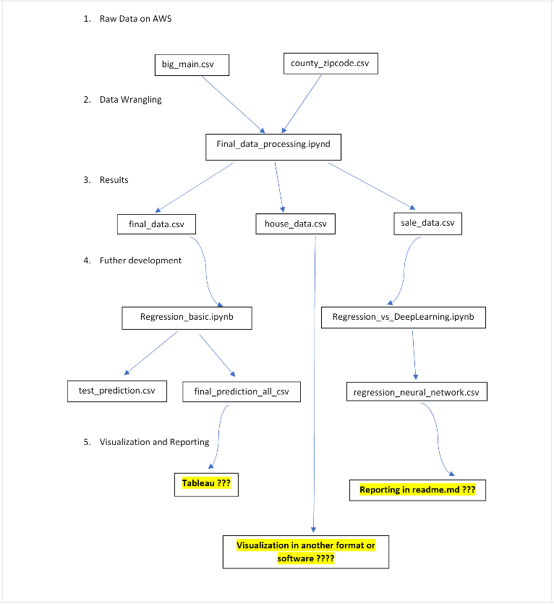
Final ETL Process
Sri to add key point to describe the Process

Slide 6
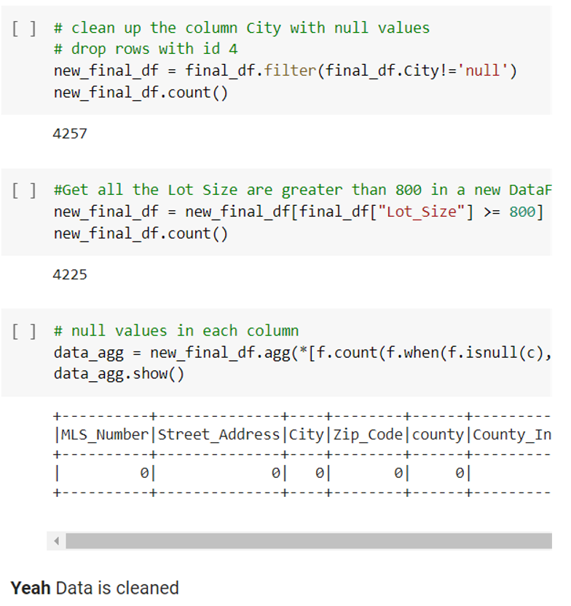
Data Processing
Dawit to add key point to describe the Process

Slide 7
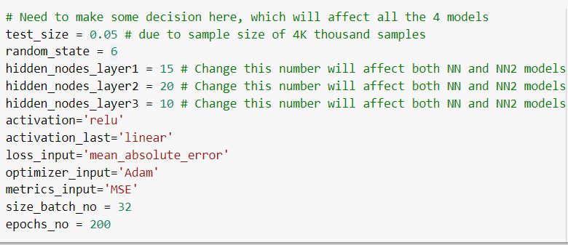
* Connection * Regression * Neural Network
* Use google Colab and pyspark, and process this online
* Export the processed data to postgresql: 'house_data.csv', 'sale_data.csv' and 'final_data.csv’
* Final_Regression_NN.ipynb
* Read the 'final_data.csv' from AWS
* a merge of Regression and Neural Network learnings
* same number of X_train, y_train, X_test, and y_test data points
* A total of 4 models
Trong-Quyen Nguyen

Slide 8
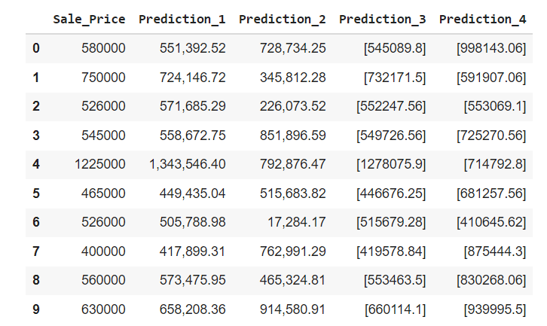
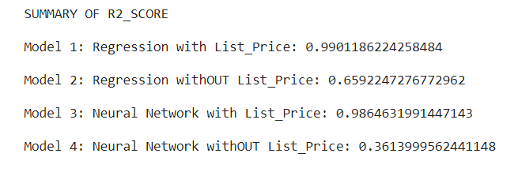
* Connection * Regression * Neural Network
Trong-Quyen Nguyen

Slide 9
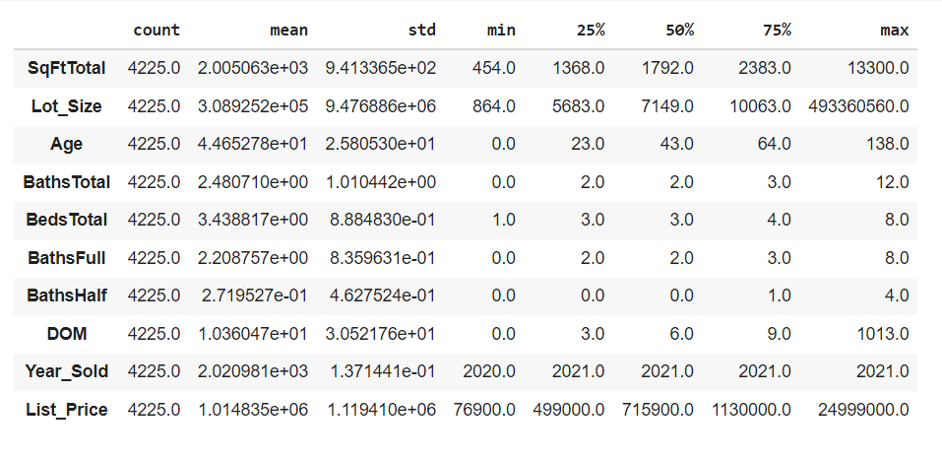
* Connection * Regression * Neural Network
Trong-Quyen Nguyen
So, what is the role of “List Price”?
* Quantity vs Quality

Slide 10
Dashboard
Data Cleanup –Phase1
Michael to add key point to describe the Process

Slide 11
Final Project outcome , Dashboard and visualization
Using Tableau to visualize the following analysis outcome:
Present at the county level in Ca the Avg. Sale Price vs. Predicted Ang. Price, Min Max Price Per SQF
Top 5 Areas with the Highest prices.
Bottom 5 areas with the lowest prices. l
Michael to add key point to describe the Process

Slide 12
Recommendation for future analysis
TBD
Michael to add key point to describe the Process

Slide 13
Technologies, languages, tools, and algorithms used throughout the project
Python : Pandas, PySpark
SQLAlchemy
Postgres
Google CoLab
Google Docs.
Python ML Models: Linear regression , Keras for neural network ML Model.

Slide 14
Backup

Slide 15
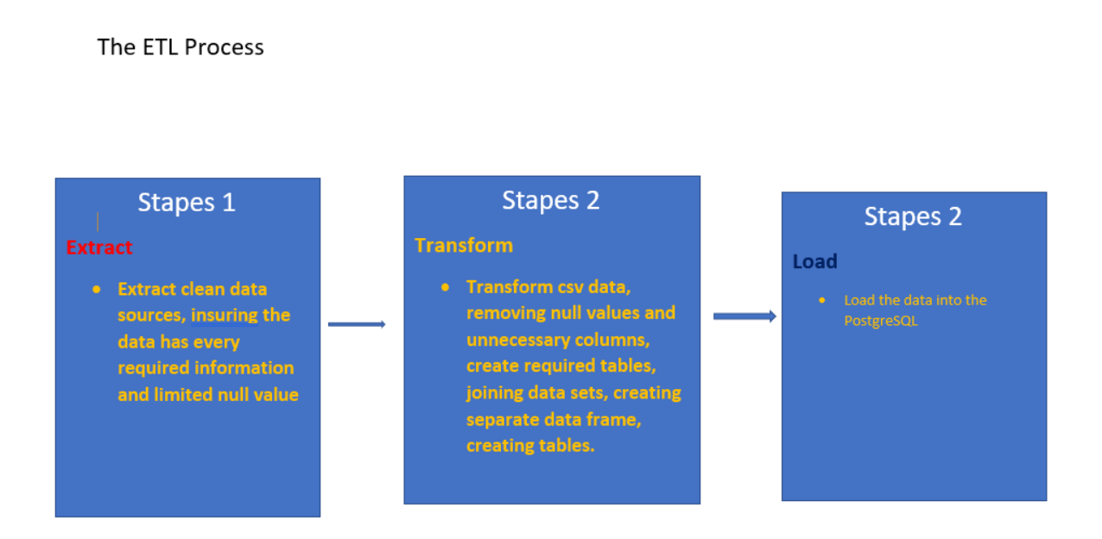
Initial Etl process

Slide 16
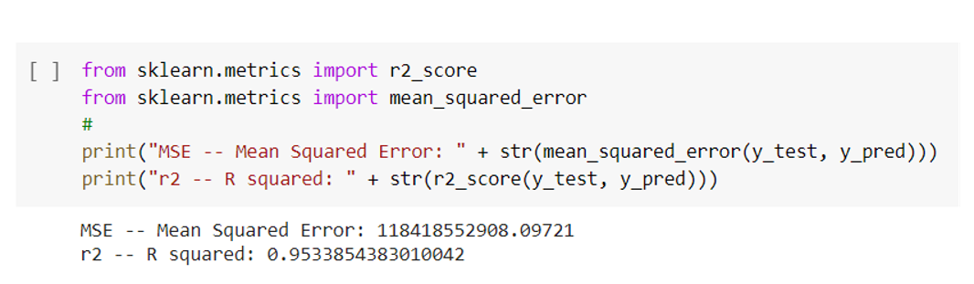
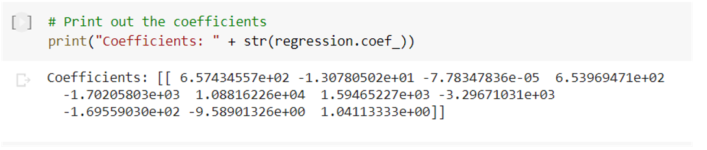
REGRESSION model
Run ML Linear regression using sklearn model

Slide 17
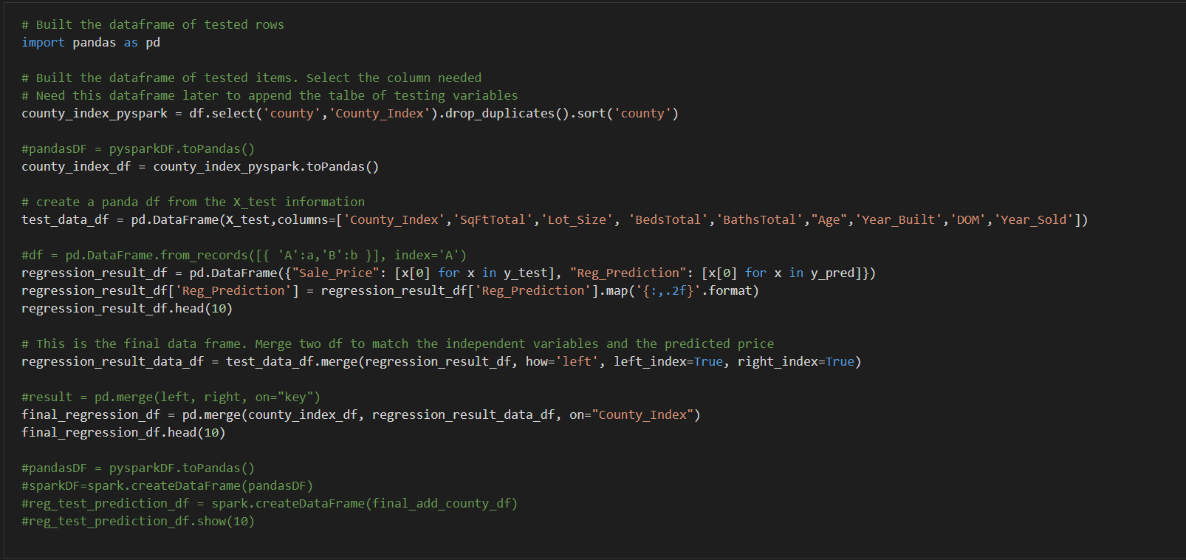
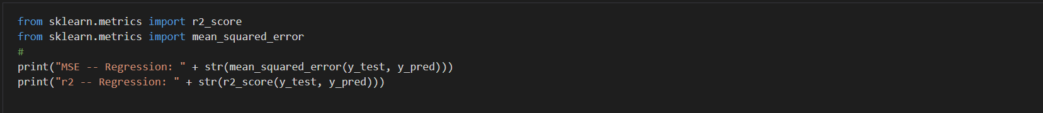
REGRESSION mODEL
Run ML Linear regression using sklearn model

Slide 18
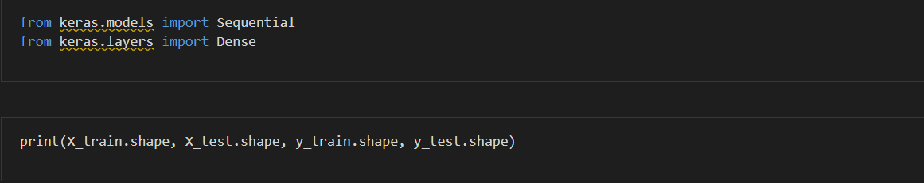
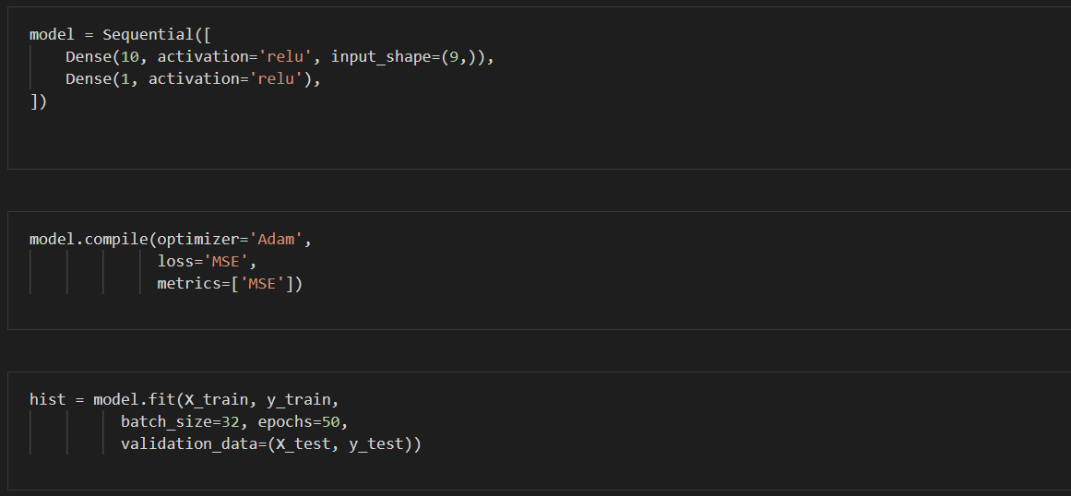
Deep Learning model
Run ML Neural Network DL ML Model

Slide 19
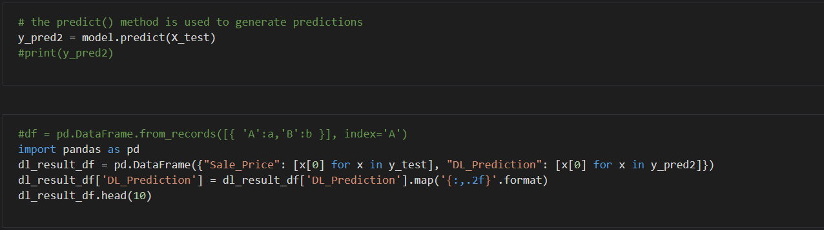
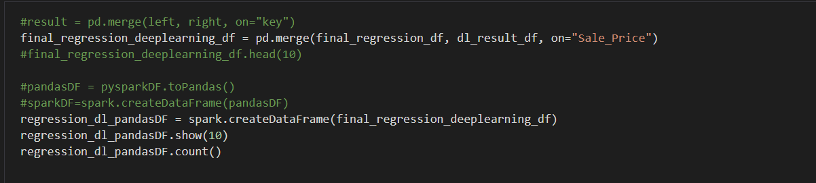
Deep Learning model
Run ML Neural Network DL ML Model - Cont

